Slide 1
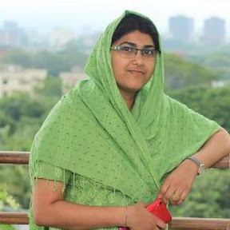
Biodata
Name: Shahnaj Begum
Upper Division Assistant at Department of Computer Science & Engineering

Slide 2
More About Myself
shahnaj2011@gmail.com
Phone: 01734868131

